Slide 1

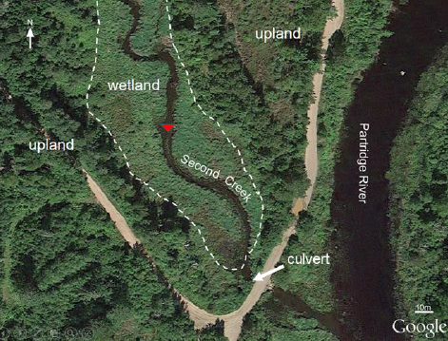
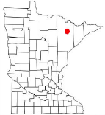
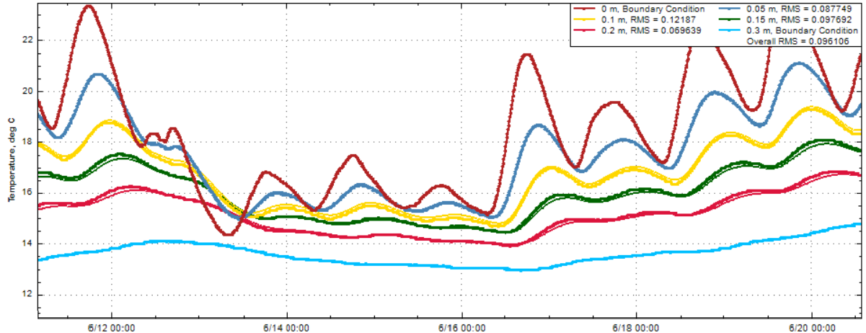
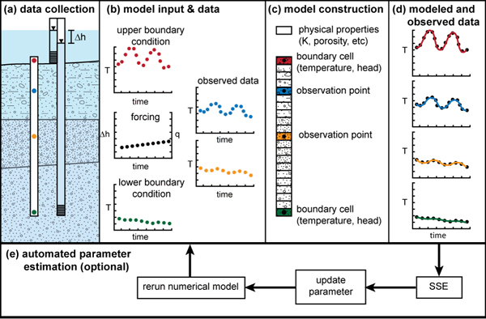
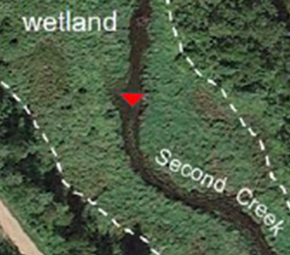
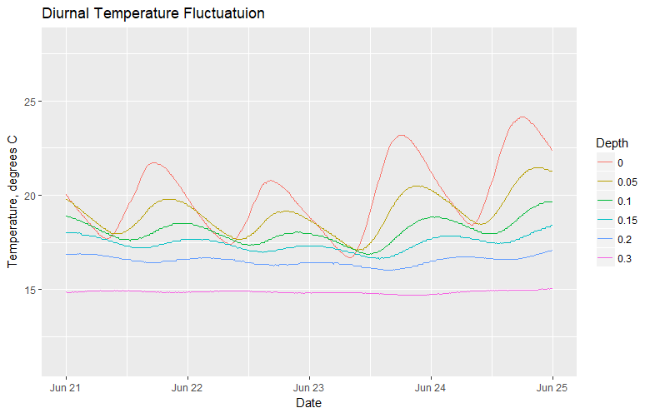
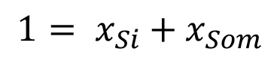
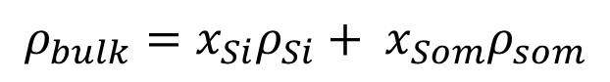
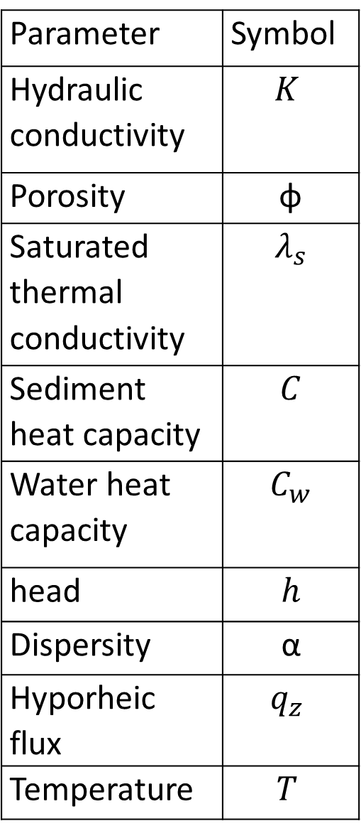
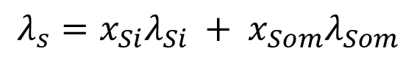
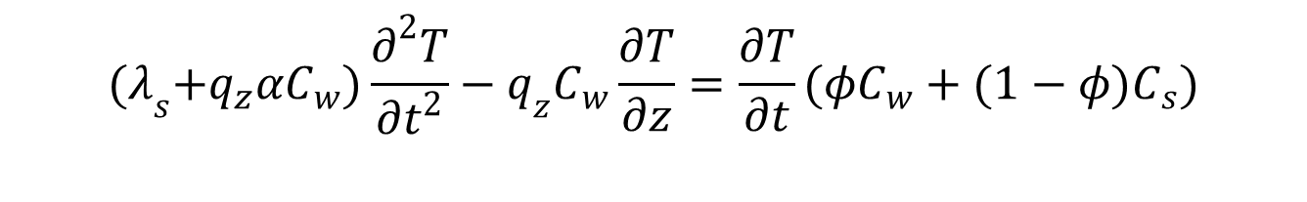
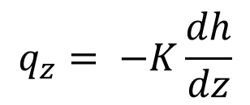
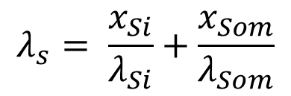
Quantifying Surface water-Groundwater exchange using Temperature Profile Inverse modeling in a Riparian Wetland
number
Jack Lange¹, G.-H. Crystal Ng¹, Amanda R. Yourd¹, Chad Sandell¹ , Andrew D Wickert¹
¹Dept. of Earth Sciences, University of Minnesota Twin-Cities
Study Site and Motivation
Sediment characterization
Model fit and sensitivity analysis
Second Creek is a wild rice stream located in Minnesota’s Iron Range
Want to understand how mining derived sulfate affects biogeochemical cycling at Second Creek
Especially interested in hyporheic zone because it has strong influence on aquatic plants rooted there ((Hayashi & Rosenberry 2002; Kurtz et al.)2007).)
Hyporheic flux controls the sediment geochemical gradient
Goal:quantify hyporheic flux at the site
Regional flow west to ease
Wetland
Stream
Channel
Stream
channel
Heat capacity sensitivity plottt
Sediment is characterized by high organic content, low dry bulk density, high porosity (myrbo)
Dry bulk density used to estimate the fraction silicate and SOM (80-90% SOM)
Thermal properties constrained based on Farouki et al – low conductivity, high heat capacity (high porosity and high organic content).
Inverse Model Theory
Include sse error on each
$$ρ_{bulk}=x_{Si}ρ_{Si}+ x_{Som}ρ_{som}$$
$$λ_{s}= \frac{x_{Si}}{λ_{Si}}+\frac{x_{Som}}{λ_{Som}}$$
Parameter | Symbol
Hydraulic conductivity | $$K$$
Porosity | φ
Saturated thermal conductivity | $$λ_{s}$$
Sediment heat capacity | $$C$$
Water heat capacity | $$C_{w}$$
head | $$h$$
Dispersity | α
Hyporheic flux | $$q_{z}$$
Temperature | $$T$$
$$1= x_{Si}+x_{Som}$$
$$λ_{s}=x_{Si}λ_{Si} + x_{Som}λ_{Som}$$
Hydraulic conductivity, m/d
Hydraulic conductivity varies with location , see image of soils
Results
Most sensitive param:: thermal conductivity
Conclusions
Stream center | 0.17529
West wetland | 0.07024
Stream west | 0.042949
consistent upwards flux
Head is variable with position
Koch et al. 2015
Forward model governing equations
0.18 m/d
$${(λ}_{s}+q_{z}αC_{w})\frac{∂^{2}T}{∂t^{2}}−q_{z}C_{w}\frac{∂T}{∂z}=\frac{∂T}{∂t}(φC_{w}+(1−φ)C_{s})$$
Flux at each pont over summer
Future work
$$q_{z}= −K\frac{dh}{dz}$$
Data collection
Expand to 2017, 2018 data sets
Rainfall data
Three temperature probes were collocated with PZ’s
conjunction with mini piezometer wetlands.
the bottom thermistor was located at approximately 30-40
cm depth below the sediment-water interface, with most sensors clustered within the top
10 cm, which corresponds to the wild rice root zone. Temperature readings were logged
at 15 minute intervals to capture diurnal variability over the summer
PZ and stream gauge, plus baro transducer to get thead
Capture heterogeneity in parameters
Need a blurb from Andy about data loggers, and maybe an image
References
Myrdo’ bulk density and porosity
Yourd, A., 2017. Using reactive transport modeling to link hydrologic flux and root zone geochemistry at Second Creek, a sulfate enriched wild rice stream in northeastern Minnesota, Masters Thesis, University of Minnesota.;
Stallman 1965,
Farouki, O., 1961. Thermal properties of soils. United States Army Corps of Engineers Cold Regions Research and Engineering Laboratory.;
Mybro, A., 2013. Wild Rice Sulfate Standard Field Surveys 2011, 2012, 2013: Final Report. University of Minnesota.;
Hayashi, M. & Rosenberry, D.O., 2002. Effects of Groundwater Exchange on the Hydrology and Ecology on Surface Water. Groundwater.;
Kurtz, A.M. et al., 2007. The importance of subsurface geology for water source and vegetation communities in Cherokee Marsh, Wisconsin. Wetlands.;
Koch et al. 2015., 1DTempPro V2: New Features for Inferring Groundwater/Surface-Water Exchange, Groundwater.;
Healy, R.W., and A.D. Ronan. 1996. Documentation of computer program VS2DH for simulation of energy transport in variably saturated porous media – modification of the U.S. Geological Survey’s computer program VS2DT. U.S. Geological Survey Water-Resources Investigations Report.;

